Slide 1
EXPORT MARKETING
Dr. Sumita Shankar

Slide 2
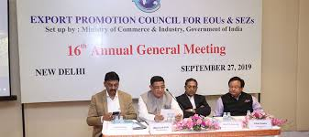
EXPORT PROMOTION AGENCIES

Slide 3
EXPORT PROMOTION COUNCIL (EPC)
EPCs are registered under companies Act. 1956
Also under societies registration Act as non profit organisation.
There are 27 EPCs in India
These councils deal with commodities live cotton, textiles, gems plastic, Marine products, silk , handloom , cashew , engineering goods, tobacco, computer software etc.

Slide 4
EXPORT PROMOTION COUNCIL (EPC)
All members of EPCs are given Registration –cum-Membership Certificate ( RCMC)
This certificate is useful to exporters to get the benefits of various concessions and incentives offered by GOI

Slide 5
FUNCTIONS OF EPCs.
1. Provide information
2. Provide Assistance
3. Collects data
4. Acting as liaison
5. Sending and inviting trade delegates
6. Opening offices abroad.
7 . Acting as registering authority

Slide 6
FUNCTIONS OF EPCs.
8. Motivating exporters
9. Offering guidance
10. Settling trade disputes
11. Issuing Certificate of Origin

Slide 7
Services offered by EPCs.
1. Providing information on trade enquiries
2. Supplying reliable information
3. Sponsoring trade delegates
4. Providing publicity
5. Solving problems of exporters

Slide 8
Services offered by EPCs.
6. Display of products
7. Settling disputes
8. Providing benefit of incentives
9. Providing benefit of incentives
10. Exploring overseas market.
11. Assisting Government
12. Developing export consciousness

Slide 9
Role of EPCs.
EPCs have official status , the act as friend and guide of Indian exporters
They provide new activities and new services to exporters

